Slide 1

Data Analytics
Presented by
Gayathri

Slide 2
Problem Statement
Blinkit, a leading quick-commerce grocery delivery platform, seeks to optimize its end-to-end business operations by analyzing customer purchasing behavior, delivery performance, inventory management, marketing effectiveness, and customer satisfaction metrics.
The goal is to identify growth levers, improve operational efficiency, personalize customer engagement, and build predictive models for delivery time estimation, customer segmentation, and sales forecasting to drive profitable and scalable growth.

Slide 3
Dataset overview
The Blinkit dataset captures detailed operational data of an online grocery delivery business. It includes customer demographics and order history, customer feedback with sentiment, delivery performance metrics, inventory stock records, marketing campaign data, and detailed product information.
This dataset helps analyze customer behavior, delivery efficiency, product management, and marketing effectiveness to optimize business decisions.

Slide 4
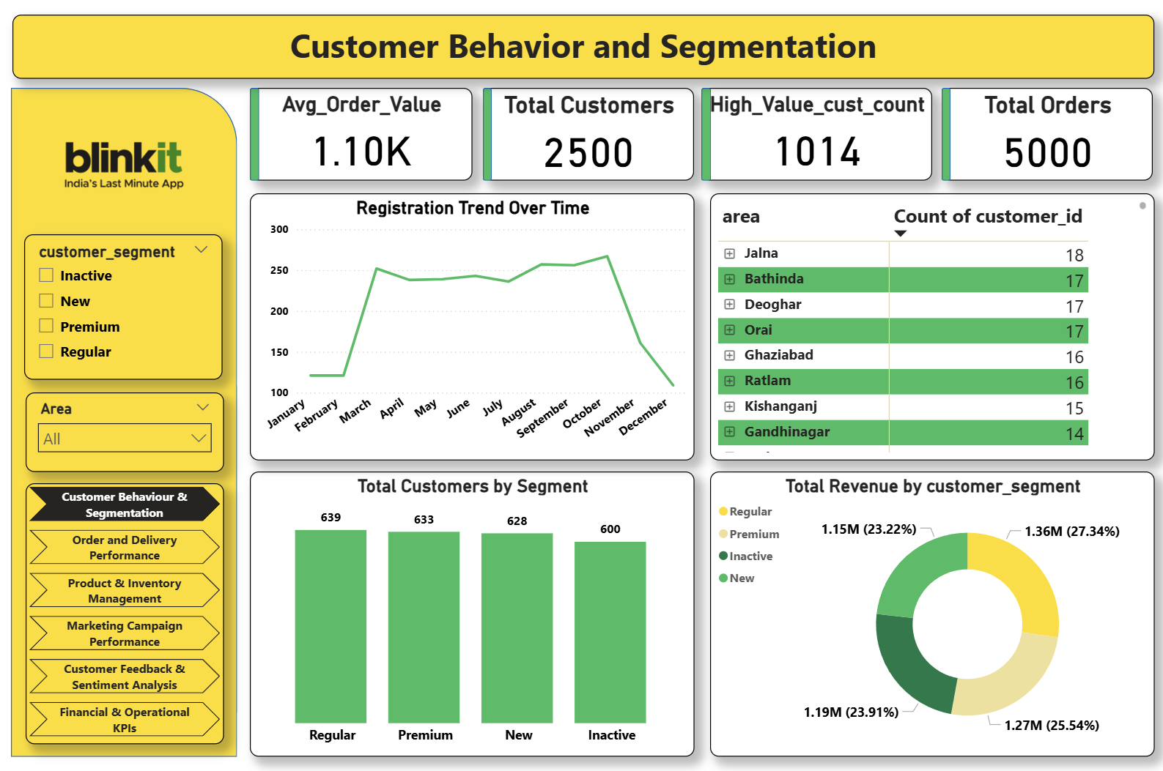

Slide 5
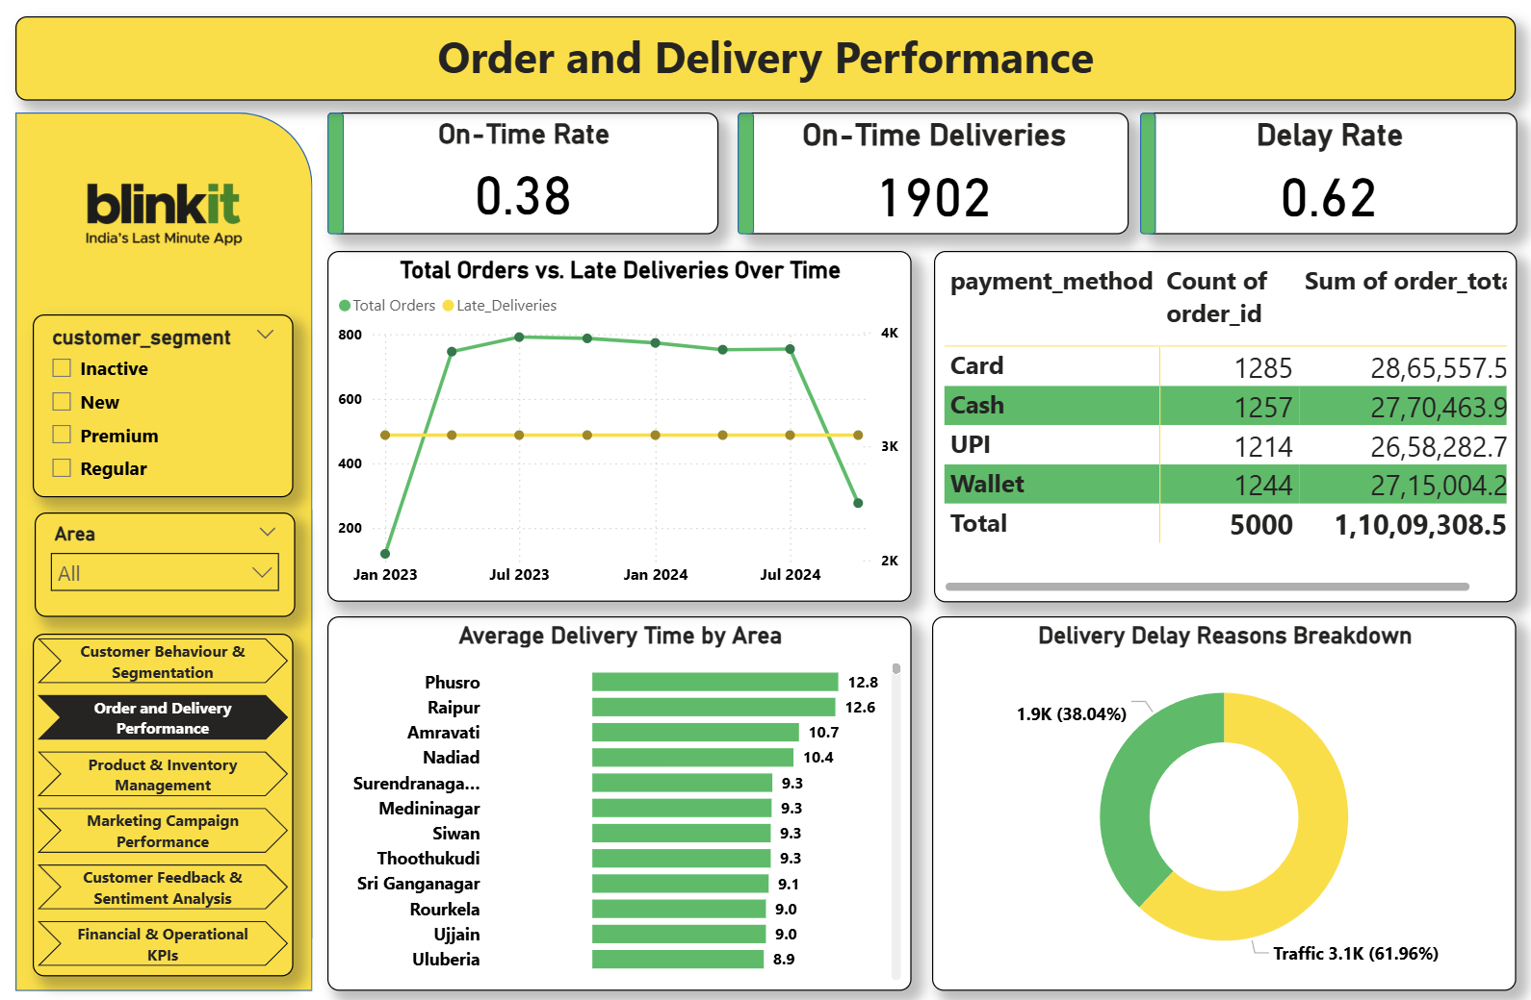

Slide 6
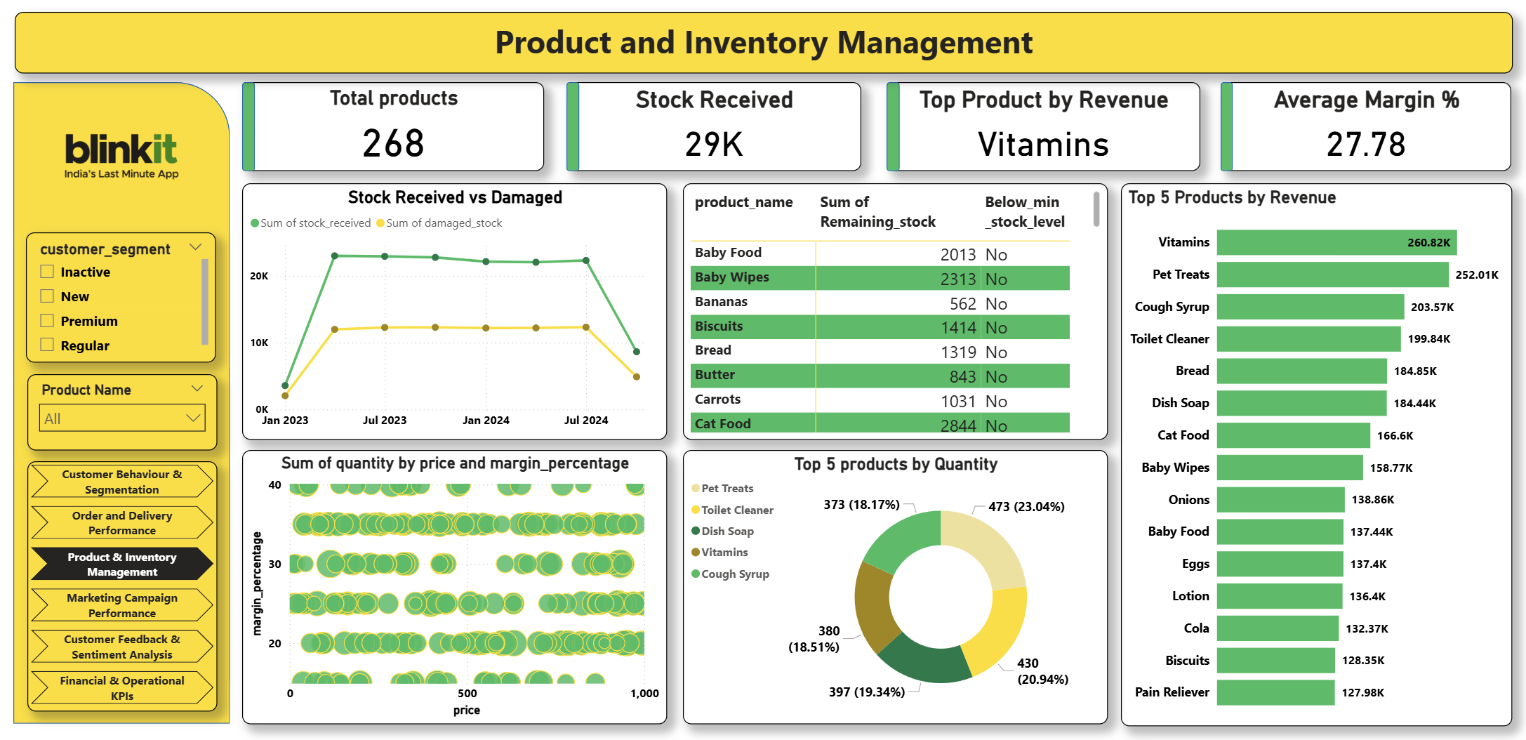

Slide 7
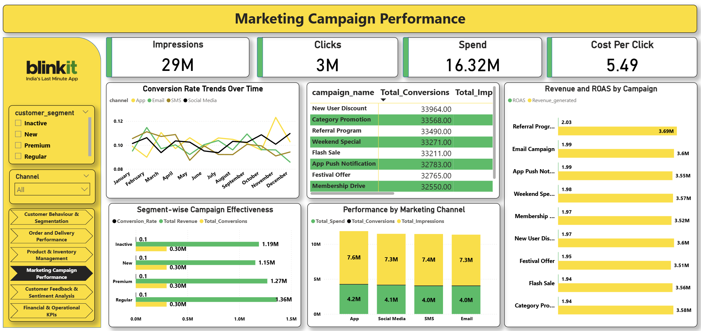

Slide 8
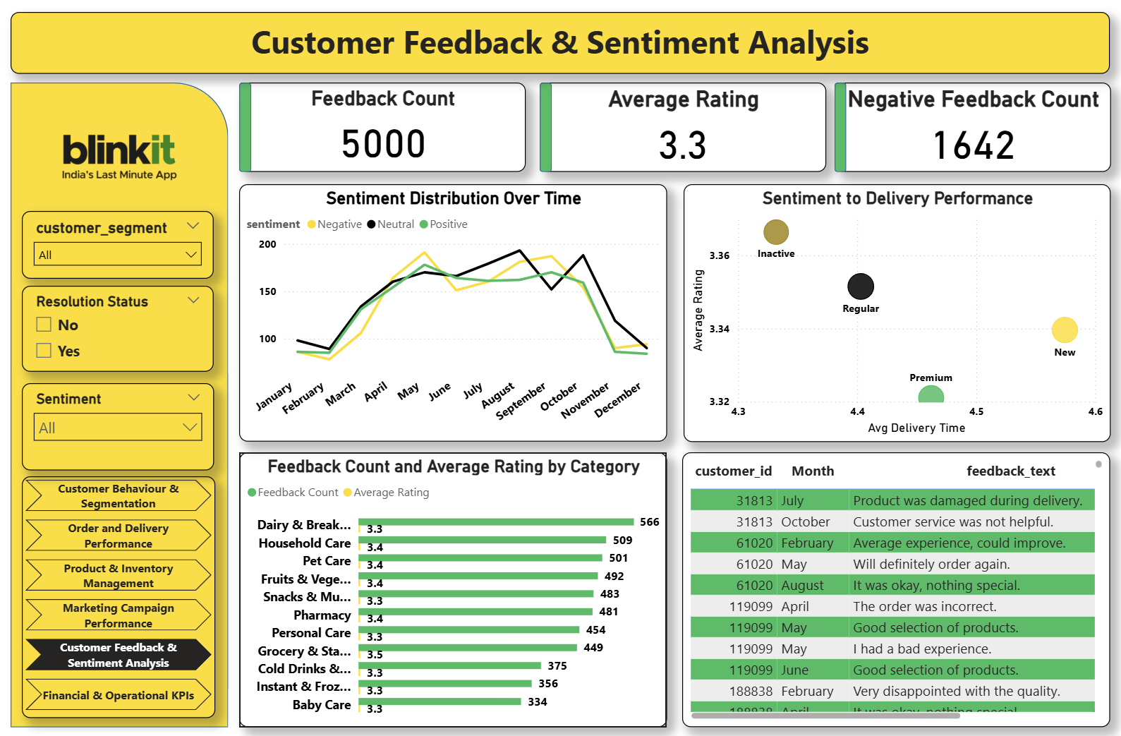

Slide 9
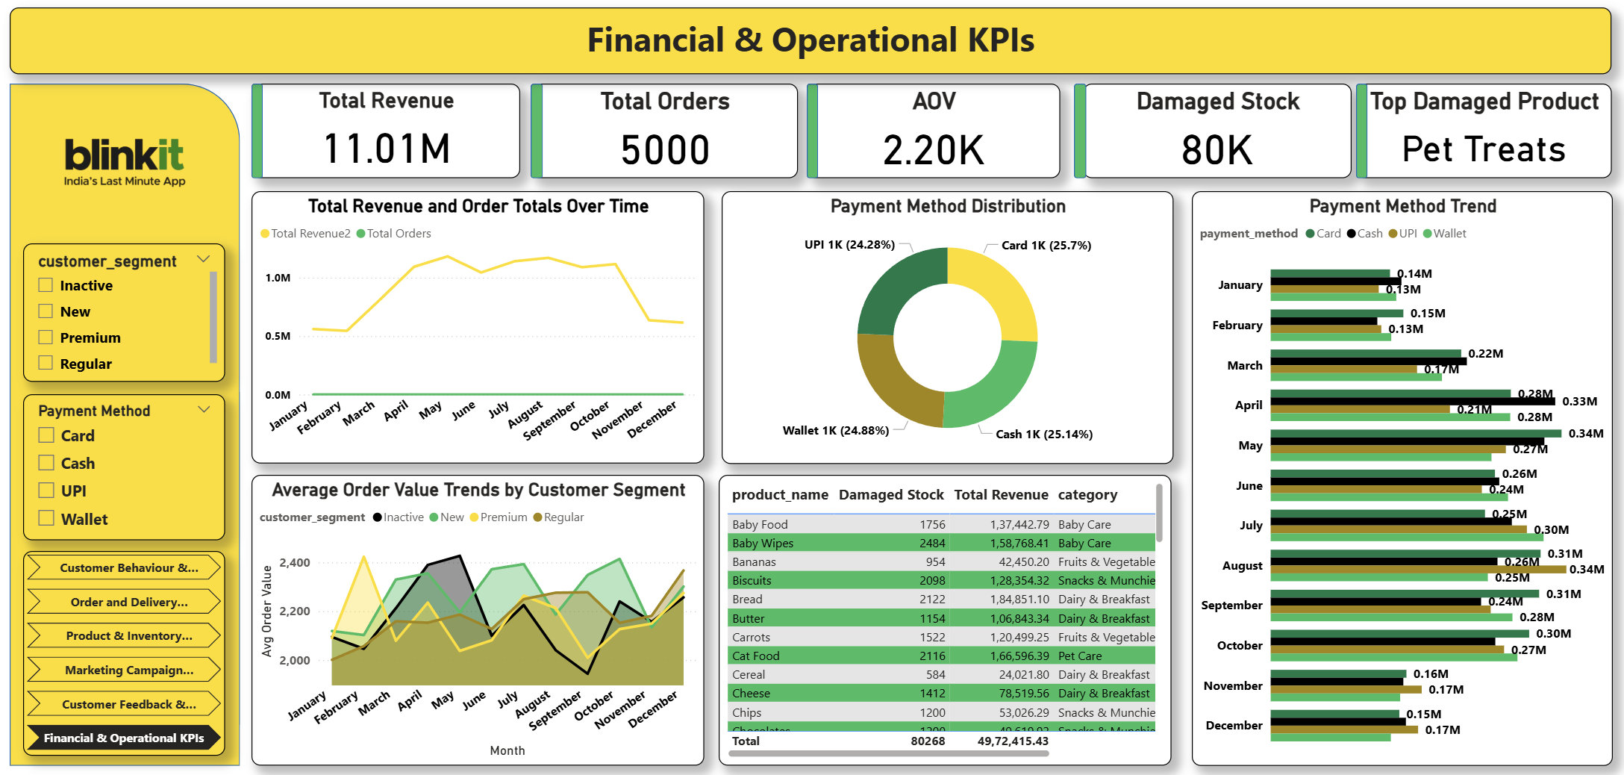

Slide 10
This end-to-end data analytics project for Blinkit provided deep insights into customer segmentation, product performance, inventory trends, and operational efficiency. Key highlights include: - Identified high-value customer segments and optimized engagement strategies. - Analyzed delivery performance and delay reasons for operational improvements. - Monitored stock damage trends and flagged low-stock products to reduce inventory risk. - Highlighted top-selling products by revenue and quantity to support demand planning. - Established the foundation for predictive models in customer segmentation, delivery time estimation, and sales forecasting.
Final Summary

Slide 11
Thank you

